Slide 1


EMOTION-BASED MUSIC RECOMMENDATION SYSTEM
SRM VALLIAMMAI ENGINEERING COLLEGE (An Autonomous Institution) SRM Nagar, Kattankulathur – 603 203.
RANJITH.R
142219104095
GUIDED BY
Dr. G. Kumaresan
B.E.,M.E.,M.B.A.,Ph.D
Assistant Professor (Selection Grade)
SABARISH.M
142219104104
SURYAKUMAR.S
142219104133
SAMUEL JAYARAJ.J
142219104108
1

Slide 2
ABSTRACT
Music is the form of art known to have a greater connection with a person’s emotions. It has got a unique ability to lift one's mood. If a user receives a recommendation based on his preference, it will also improve his listing experience. Music recommendations have existed for a long time. Still, in most scenarios, the recommendation is decided after learning the user preferences over time, like looking at their past song preferences, the amount of time they listen to the music, etc. This paper suggests a neural network-based approach to song recommendation where facial expressions detect a person's mood. This approach is more efficient than the existing ones and eases users' work of first searching and creating a specific playlist. Facial expressions play a crucial role in detecting a person's mood. A webcam or camera is used to picture a face, and input is extracted from that picture. This input is also used for determining an individual's mood.

Slide 3
INTRODUCTION
The new prospect in the realm of music information retrieval is the automatic analysis and interpretation of music by computers. A wide range of study issues in this area is studied by scholars due to the diversity and depth of music material, including computer science, digital signal processing, mathematics, and statistics used in musicology. Automatic audio genre/mood categorization, music similarity calculation, audio artist identification, audio-to-score alignment, query-by-singing/humming, and other recent developments in music information retrieval are only a few examples.
One of the practical applications that may be offered is music suggestion based on content. We can create more sophisticated context-based music recommendations using the context information. The development of a content-based music recommendation system requires multidisciplinary efforts such as emotion description, emotion detection/recognition, feature-based categorization, and inference-based recommendation. An emotion descriptor has been used to successfully characterize music taxonomy. Emotions may be translated into a set of real numbers as a set of continuous values, which is a presumption for emotion representation.
3

Slide 4
INTRODUCTION cont.
Over the years, researchers categorized music in different ways. Russel’s model described music as two bipolar dimensions, pleasant-unpleasant and arousal-sleep. Thayer’s model suggested arousal and valence aspects on a two-dimensional plane which can be divided into four quadrants with eleven emotion adjectives superimposed on top. Xiang et al proposed a mental state transition network that consist of happy, sad, anger, disgust, fear, surprise, and serene.
Automatic emotion identification and recognition in music is developing quickly because to advancements in digital signal processing and many efficient feature extraction techniques. Many other potential applications, including music entertainment and human-computer interaction systems, can benefit from emotion detection and recognition.
The first study on emotion recognition using music was presented by Feng. They applied the Computational Media Aesthetics (CMA) point of view by examining two tempo and articulation variables that are mapped into four types of moods: joy, rage, sadness, and fear.

Slide 5

OBJECTIVE OF THE PROJECT
To provide customized music through an interface for the music system.
To give users excellent entertainment.
To put machine learning concepts into practice.
To provide music enthusiasts with a modern platform.
To close the gap between music practices and evolving technology.

Slide 6
LITERATURE SURVEY
Title: A Deep Music Recommendation Method Based On Human Motion Analysis
Author: Wenjuan Gong, Qingshuang Yu | Publication Year: 5 Feb, 2021
The problem of music recommendation from dance motion has seldom been explored. To solve this problem, this paper proposed an algorithm based on dance motion analysis and evaluate it through the quantitative measures. This implements LSTM-AE(Long Short Term Memory Auto Encoders) based music recommendation method, that learns relationship between motion and music. The proposed method reaches accuracy of 91.3% using Late Fusion of Joint and Limb features.
6

Slide 7
LITERATURE SURVEY
Title: Deep Neural Network for Emotion Recognition based on Meta-Transfer Learning
Author: Hengyao Tang, Guosong Jiang, Qingding Wang | Publication Year: 25 Jul 2022
This paper proposed a meta – transfer learning model for emotion recognition. This model can reduce the amount of data required by the meta-learning optimization Algorithm. Even with the small amount of data for training, it give good performance, thereby reducing the EEG(Electroencephalogram) acquisition and labelling. This paper mainly focussed on 2 datasets namely SEED and SEED-IV. It reaches with the accuracy of 61.2% Compared to traditional methods, this meta-learning framework reduces the dependencies on training subjects with inly a small sample size.
7

Slide 8
LITERATURE SURVEY
Title: Multimodal Emotion Recognition Fusion Analysis Adapting BERT with Heterogeneous Feature Unification
Author: Sanghyun Lee, David K. Han Hanseok Ko | Publication Year:9 Jul, 2021
In this paper, they represent a new multimodal emotion recognition approach that improves the BERT(Bi-Directional Encoder Representations from Transformers) model fir emotion recognition by combining it with heterogeneous features based on language, audio and visual modalities. They improved the BERT model with the heterogeneous features of the audio and visual modalities. They introduced the Self-Multi-Attention Fusion Model and Video Fusion Model which are attention based multimodal fusion mechanisms using the recently proposed transformers architecture. The limitations of this model was increased computation due to the generation of more trainable weights and hyperparameters.
8

Slide 9
LITERATURE SURVEY
Title: Efficient-SwishNet Based System for Facial Emotion Recognition
Author: Tarim Dar, Ali Javed, Sami Bourouis (et all). | Publication Year: 11 July 2022
This paper presents a novel light-weight efficient-swishnet model for emotion recognition. They’ve introduce a low cost, smooth unbounded above and bounded Swish activation function int their model. It includes five datasets CK+, JAFFE, FER-2013, KDEF, FERG. Limitations this model is unable to perform well in case of occlusion, where face is covered with accessories like glasses, masks, hair etc. Future works, to overcome this limitation and improve the model’s accuracy on FER and also plan to create a custom FER dataset.
9

Slide 10
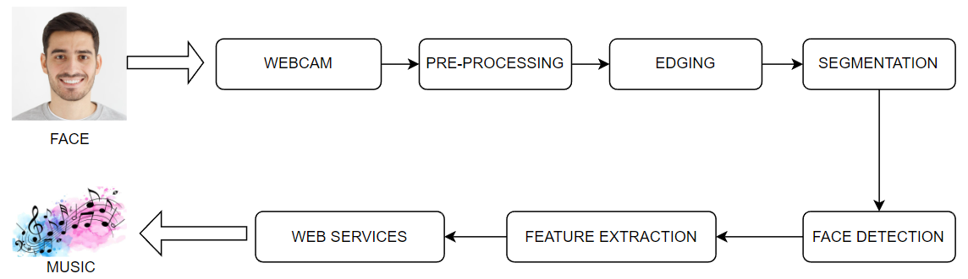
SYSTEM ARCHITECTURE
Through the camera, the person's face is captured. Frames from the captured video are created. Using preprocessing, the collected pictures are used to transform the facial expression into a series of Action Units (AUs). Following feature extraction, the emotions are divided into four groups: surprised, happy, angry, and sad. Using integrated web services, the music based on the detected emotions is selected and played.

Slide 11
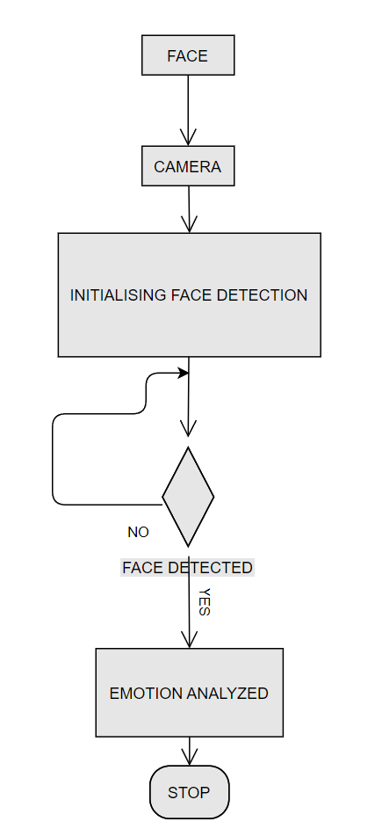
MODULES
FACE DETECTION
By minimizing outside sounds and other circumstances, the face identification module's primary goal is to identify the face in the frame. The Models and libraries used in the FACE DETECTION PROCESS are as follows:
1. HaarCascadeClassifier
2. DeepFace
3. OpenCV - Python
Flow Diagram of Face Detection Module

Slide 12
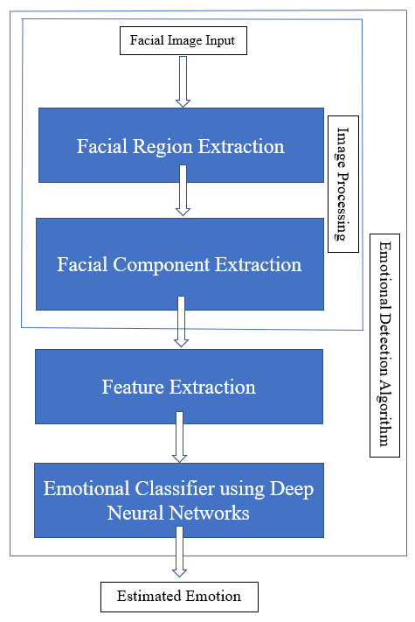
MODULES
EMOTION CLASSIFICATION
After the successful completion of the face detection process. The emotions detected on the face are identified through the following processes:
1. CNN Layers
2. MobileNetV2 – Pretrained Model
3. Training and Testing on FER2013 Dataset
4. Real Time Detection and Classification of Emotion based on 7 classes.
Flow Diagram of Emotion Classification Module

Slide 13
MODULES
MUSIC RECOMMENDATION
Upon emotion classification, the songs corresponding to one of the four detected facial emotions:
are identified and played to the user.
1. Angry | 5. Neutral
2. Disgust | 6. Sad
3. Fear | 7. Surprise
4. Happy

Slide 14
MODULES
WEB APP DEPLOYMENT
Once done with all the things, finally presenting our model with the nice GUI based Web APP.
Frontend tool to be used – HTML, CSS, JS, API.
Backend tool to be used – Flask, Python.

Slide 15
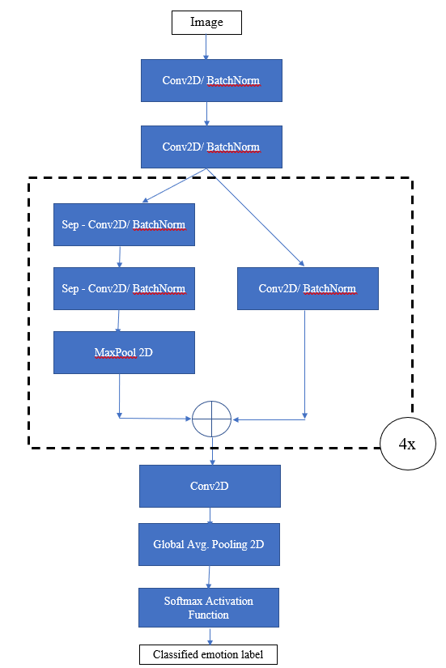
ARCHITECTURE
The picture depicts the architecture of our Deep Neural Network model for Emotional Classification.

Slide 16
CONCLUSION
To conclude, we show a model that uses multiple emotions gleaned from facial expressions to recommend music. To complete our research, we used ideas from Face Detection, Emotion Classification, Deep Neural Network and other related fields. Music is something that permeates all aspect of our life; it affects us in moments of joy, grief, rage, or even simply boredom. Our team has been able to build something that can deepen our relationship with music and offer fascinating experiences thanks to modern innovations.

Slide 17
REFERENCES
[1] Anagha S.Dhavalikar and Dr. R. K. Kulkarni, “Face Detection and Facial Expression Recognition System” 2014 Interntional Conference on Electronics and Communication System (ICECS -2014).
[2] Yong-Hwan Lee , Woori Han and Youngseop Kim, “Emotional Recognition from Facial Expression Analysis using Bezier Curve Fitting” 2013 16th International Conference on Network-Based Information Systems.
[3] Arto Lehtiniemi and Jukka Holm, “Using Animated Mood Pictures in Music Recommendation”, 2012 16th International Conference on Information Visualisation.
[4] F. Abdat, C. Maaoui and A. Pruski, “Humancomputer interaction using emotion recognition from facial expression”, 2011 UKSim 5th European Symposium on Computer
[5] T.-H. Wang and J.-J.J. Lien, “Facial Expression Recognition System Based on Rigid and Non-Rigid, Motion Separation and 3D PoseEstimation,” J. Pattern Recognition, vol. 42, no. 5, pp. 962-977, 2009.
[6] Renuka R. Londhe, Dr. Vrushshen P. Pawar, “Analysis of Facial Expression and Recognition Based On Statistical Approach”, International Journal of Soft Computing and Engineering (IJSCE) Volume-2, May 2012.
[7] Anukriti Dureha “An Accurate Algorithm for Generating a Music Playlist based on Facial Expressions” : IJCA 2014.
[8] Bruce Ferwerda and Markus Schedl “Enhancing Music Recommender Systems with Personality Information and Emotional States”: A Proposal: 2014.
17

Slide 18
TEAM PRESENTATION
Ranjith R
142219104097 DEPARTMENT OF CSE
SRM Valliammai Engineering College
ranjithrr2001@gmail.com
Sabarish M
142219104104 DEPARTMENT OF CSE
SRM Valliammai Engineering College
sabarishsabarish89@gmail.com
Suryakumar S
142219104133 DEPARTMENT OF CSE
SRM Valliammai Engineering College
ssuryakumar2077@gmail.com
Samuel Jayaraj J
142219104108 DEPARTMENT OF CSE
SRM Valliammai Engineering College
samueljayaraj@gmail.com

Slide 19
THANK YOU

